Slide 1
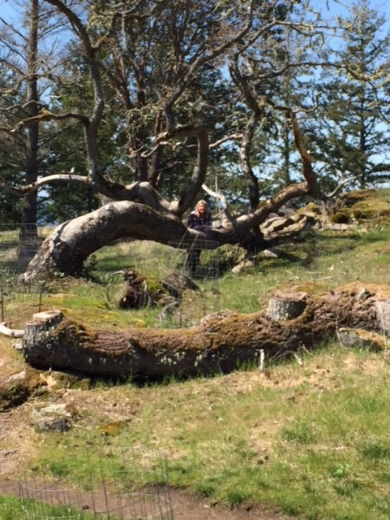
Building Resilience in Children and Families
Dean Moshofsky, MD
Notes:
Thank you for inviting me to talk today on a subject that I have a great deal of passion for.
Today we are going to discuss the topic of resilience:
What it is
What the benefits are
And how to build it.
And the best thing is that you do many of these things already –
All we are going to do is frame it a little differently
Label it resilience-building
And we’re going to show you the evidence that shows how repeating these interventions regularly will give us best results.
This is a picture of what I call our resilience tree. My wife Sarah and I came across this tree and others like it while hiking on Orcas Island.
This tree was knocked down in a windstorm – flattened
But it didn’t die. What you can’t see in this picture is how there are strong branches growing up from the trunk, reaching for the sky.
It withstood that trauma, put down deeper roots, and continued to grow
Not only did it survive that trauma, it grew stronger in the process and is now better prepared for the next windstorm that comes along

Slide 2
Goals for Today
Review Trauma and Trauma-Informed Care
Define Resilience and demonstrate its life-long benefits
Demonstrate the scientific basis showing how brain integration is beneficial in building resilience
    For Children
    For Trauma Survivors
4. Demonstrate Tools that build resilience
Notes:
These are the goals that I would like to cover today.
1. Review Trauma and Trauma-informed care
We will define resilience and demonstrate its benefits in overcoming trauma and stress.
Demonstrate the scientific basis showing how brain integration is beneficial in building resilience
For Children
For Trauma Survivors
4. We will show you tools that you all can use for building resilience in your patients and families.

Slide 3
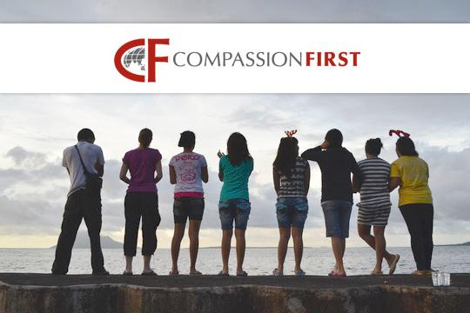

Background
Notes:
I’ve been in pediatric practice for over 30 yrs and have gained a lot of experience
But my credibility for speaking on this topic comes out of the work that I do outside of my office.
I’ve been involved with the nonprofit group Compassion First for 13 years
Together with my wife Sarah we are directors overseeing care of 3 aftercare shelters in Indonesia, taking care of teenage girls who have been rescued from sexual trafficking.
We have learned a lot about trauma and how to care for trauma survivors
We started a resilience-building program in our shelter before it was ever considered in our country.
I am proud to say that our Indonesian staff are world leaders in aftercare, and particularly in the area of resilience-building

Slide 4
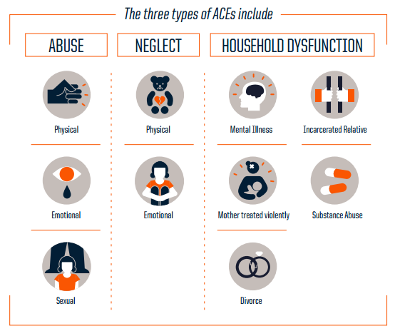
Review: 1998 ACEs Study
Vince Felliti MD, Robert Anda MD
Notes:
It was the 1998 ACEs study by Vince Felliti and Robert Anda that started this process looking at how trauma in one’s childhood can have detrimental effects that last a lifetime.
For this study ACEs were defined as
Physical, emotional, or sexual abuse of a child
Physical or emotional neglect
Or household dysfunction including
parents with mental illness
Parents who were incarcerated,
substance abuse,
domestic violence,
divorce.

Slide 5
New Information
Additional ACES
Community Violence
Homelessness
Discrimination
Foster Care
Bullying
Repeated medical procedures or life-threatening illness
Death of Caregiver
Loss of caregiver due to deportation or migration
          Adapted from The Deepest Well (N. Burke-Harris, MD 2018)
Notes:
Since the ACEs study of 20 years ago, researchers have come up with some additional traumas to children which should be considered ACEs.
Community Violence
Homelessness
Discrimination
Foster Care
Bullying
Repeated medical procedures or life-threatening illness
Death of Caregiver
Loss of caregiver due to deportation or migration

Slide 6
What we learned from the ACEs Study:
ACEs are Common
At least 1 ACE
4 or More ACEs*
12.5%
*The average pediatric provider will see 1-3 patients each day in clinic with an ACEs score of 4 or more.
Notes:
The ACEs study taught us that ACEs are common: 2/3 of us have at least one ACE and 12.5% or 1 in 8 have 4 or more ACEs.
It is important to know that this is not inner-city data or that done on impoverished individuals
This was a cross section of patients: …insured …. 70% college educated … 70% caucasian.
The Oregon Health Authority conducted an ACEs survey in the state of Oregon and confirmed that our rates of ACEs are similar to that of Southern California.
We see ACE survivors every day in … our offices, …. on our hospital floors …. and in our schools.
And what these numbers mean is that I see 1-3 patients in my office with an ACE score of 4 or more.
And as you will see, you may be seeing families that have a higher ACEs prevalence than this study would suggest.

Slide 7
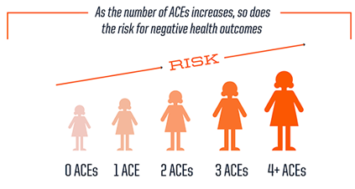
What we learned from the ACEs Study:
Dose Response for Adverse Health
Analysis from the data revealed strong correlation between childhood trauma and adverse health
The higher the ACE score, the higher the risk of medical disease in seven of the ten leading causes of death in the United States
Notes:
Analysis from the data revealed strong correlation between ACEs and adverse health
The higher the ACE score, the higher the risk of medical disease in seven of the ten leading causes of death in the United States
An ACE score > 4 doubles the risk of COPD or hepatitis, quadruples the risk of depression, and increases the risk of suicidality by 12X.
An ACE score > 7: More than triples the risk of heart disease, hypertension and lung cancer
ACEs can also influence one’s Life Span:
With 0 Aces: 60% of the population live to age 65,
With 4 Aces: 3% live to age 65,
With 7 Aces: 20 year decrease in life expectancy

Slide 8
Dose Response:
Adverse Psychosocial Health
CONDITION CORRELATION WITH ACES
Workplace Absenteeism, poor job performance, serious financial problems*
Domestic violence Perpetrating domestic violence*
Mental Health Depression, anxiety, impulse control*
Education Academic difficulties, behavioral concerns in school**
Teen Sexual health Intercourse by age 15, teen pregnancy***
* ACE Too High.com
** WSU Area Health Education Center
*** Aces Study Felliti, Anda
Notes:
This slide show the influence ACEs have on psychosocial health
Job performance
Domestic violence
Adverse mental health
Academic difficulties
Behavioral issues in school
And teen pregnancy

Slide 9
New Information: Dose Response of ACEs on
Adverse Developmental, Behavior Health
With an ACE score of 3 or more:
  A child is nearly 4 times more likely have developmental delays*
With an ACE score or 4 or more:
  A child is 32 times more likely to have behavioral problems in school**
  Source:
  * Marie-Mitchell et al, 2013
  ** Burke et al, 2011
©2017 Children’s Health Foundation and Amy Stoeber, Ph.D
Notes:
Also, IMPORTANT TO US, subsequent studies have confirmed the suspected relationship of ACEs with Development and Behavior
With an ACE score of 3 or more:
A child is nearly 4 times more likely have developmental delays
With an ACE score or 4 or more:
A child is 32 times more likely to have behavioral problems in school**
Knowing this, you all should be aware that you may be taking care of a higher percentage of parents and/or kids with high ACEs..
This gives us opportunities to provide more assistance for this family through a trauma-informed lens.

Slide 10
2014 Ted Talk:
“The science is clear: Early adversity dramatically affects health across a lifetime.”
Nadine Burke Harris, MD, MPH, FAAP
September 2014
Notes:
While this data has been percolating for the past 15-20 years, it took a TED talk in 2014 by Nadine Burke-Harris, a pediatrician in SF, to alert us to the risks of ACEs.
For many pediatricians, 2014 is when we first heard about the ACEs study.

Slide 11

“What are we going to do about it?”
Children’s Health Alliance Board of Directors
Fall, 2015
Notes:
The Children’s Health Alliance and Foundation is a group of over 100 pediatricians in the Portland, Vancouver and Salem area.
We work together to improve the care of our patients through Quality Improvement Projects.
5 years ago, when we were deciding what our next quality project was going to be,
we decided that we wanted to address ACEs but we weren’t quite sure how to do it.

Slide 12
Targeting ACEs
Understand ACEs, Trauma and Resiliency
Trauma-informed Care
Building Resilience
Building Resilience in Children and Families
Notes:
Targeting ACEs was a direct response to find a way to address ACEs by building resilience in our office setting
Targeting ACEs was designed as a three-step program that we have taken as pediatricians and you all are on the same path:
First, we taught our pediatricians about ACEs, Trauma and Resilience.
Secondly, we taught all of our pediatricians and their staff about Trauma-informed care and how we can do a better job of caring for these families.
Finally, we developed a curriculum and taught pediatricians how to build resilience.
We enlisted the help of Amy Stoeber, a local child psychologist and together we devised a curriculum for resilience-building during our office visits.
These interventions are evidence-based, and brief enough to include in a routine office visit.
And we are going to share some of them with you today.
Pediatricians are engaging in resilience building-exercises in our offices every day to target ACEs, and so can you.
We need to be building resilience in our schools, our preschools, churches and our community centers.

Slide 13

“The impact of a successful approach to ACEs might be as great as a major vaccine”
Vince Felliti MD
Co-author ACEs Study
Notes:
Here is a quote from Vince Felliti, the co-author of the ACEs study:
“The impact of a successful approach to ACEs might be as great as a major vaccine”
This quote actually spurred a thought on how we can help.

Slide 14

We Need a Vaccine for ACEs
    Target everybody
    Prevention before harm
    Long term benefits
Notes:
We need an intervention that works in the same way immunizations do:
Target the general population
Work preventatively before harm is caused.
And have benefits that last for the long term

Slide 15
The Vaccine Model for ACEs:
Intervention Steps
Introduce small dose of toxin
Let the body’s own defenses build up strength
Give booster doses over time
Herd Immunity: community protection
Notes:
Let’s review the vaccine model and show how it gives us a template for prevention of ACEs.
Introduce small dose of toxin
Let the body’s own defenses build up strength
Give booster doses over time: to build up the body’s defense so that when the true threat actually comes, the body can protect itself.
Herd Immunity: community protection

Slide 16
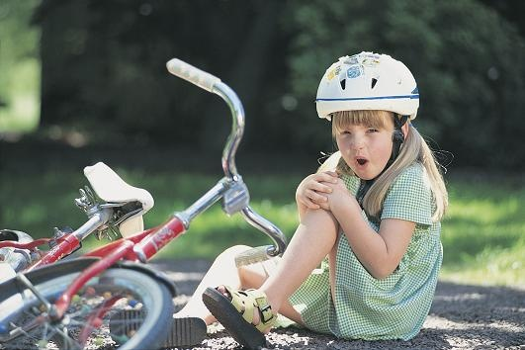
s
“Look how well you handled that. You are strong!”
Notes:
So . . . How do we do this?
Resilience building is not a lecture course, it is learned in the laboratory of life-experiences.
A girl who falls off her bike. One approach could be: “Oh honey, I’m sorry you’re hurt. Let’s go inside, clean up your booboo and have some hot chocolate.”
Perfectly fine. But a resilience-building approach could be: “Oh honey, I’m sorry you’re hurt. But look how far you went. You’re doing great. Let’s get back on the bike and see if you can ride even longer!”
Both approaches are nurturing and caring, but the second approach builds persistence, perseverance and resilience.
Opportunities to build resilience abound every day:
Learning to ride a bike,
struggles with developmental skills, or school performance
squabbles with friends or bullies on the playground.
Relationship breakups
These are all opportunities to help our kids learn patience and persistence while going through daily challenges.
Like a vaccine, we are allowing the body to build up strength gradually over time, with booster doses, preparing them for bigger threats that may come in the future.

Slide 17
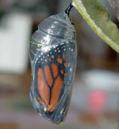
Building Strength In Our Children
Notes:
Here is a metaphor that parents can latch on to:
Have you ever seen a butterfly emerging from a cocoon. ​
They stretch and struggle and work persistently to get out of that cocoon, sometimes for hours or days. ​
Do you know what scientists found out? That if you assist that butterfly by making it easy, essentially doing the job for them: they die. ​
They don’t have the strength to be able to fly because they need to exercise those wings before they can fly on their own.
We want to teach our kids how to learn patience and persistence during struggles and difficulties to build strong and resilient youth.

Slide 18
So . . .
What’s the Vaccine for ACEs???
Resilience
Notes:
So . . . What is the vaccine for ACEs?
We believe that the most effective way that we can address ACEs is through resilience and we have research to prove it.
So . . . What is resilience?

Slide 19
Resilience
The ability to face a challenge,
    Manage or overcome the challenge,
    And to be strengthened,
  not defeated by the process
Notes:
Resilience is a word that is commonly talked about - but few people can really define what it is.
Resilience is:
The ability to face challenges,
manage the challenge or overcome it
And to be strengthened, and not defeated by the process
Resilience is not
a trait that you inherit,
or an attribute that is only found in a fortunate few.
Think of it as a capability or capacity that allows one to be strong and grow stronger.
And it is available to everyone

Slide 20


Resilience
The Ability To Bounce Back Strong

Slide 21
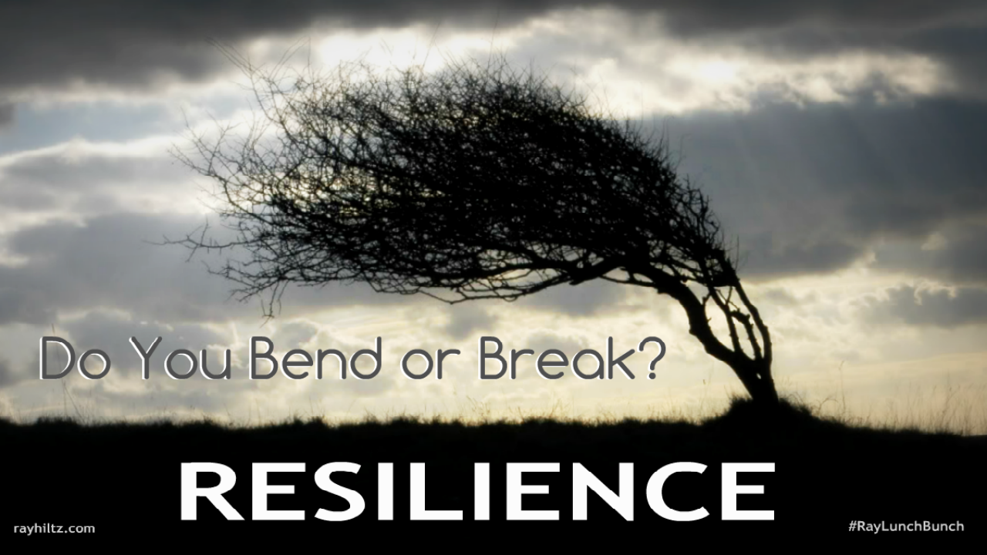
What the Research Shows
We are ALL born with the ability to be resilient
We can ALL learn to be more resilient
Resilience can be taught
Teaching resilience builds resilience in us!
Notes:
WHAT HAS RESEARCH TAUGHT US ABOUT RESILIENCE?
We are ALL born with the ability to be resilient
And we can ALL learn to be more resilient
And we can ALL teach others how to be more resilient!
AND . . . When we teach resilience, we become more resilient.

Slide 22

What we have learned in the
20 years since the ACEs Study?
Brain Plasticity
Positive-Focus
Studies of Resilience Emerge
Notes:
Twenty years ago we found out that ACEs were bad. But we didn’t do anything about it.
Why? What took so long?
It wasn’t that we didn’t care.
It is that we didn’t have the tools or knowledge of how to help.
But we have learned a lot in the past 20 years.

Slide 23
Brain Plasticity
The ability of the brain to change,
even after damage or trauma
Notes:
When I was in medical school, I was taught that the brain couldn’t change, and any brain damage that happened was permanent.
New technology has changed all that with the invention of PET scans and Functional MRI’s we are able to show that the brain can change even after suffering from damage.
We call this Brain Plasticity

Slide 24
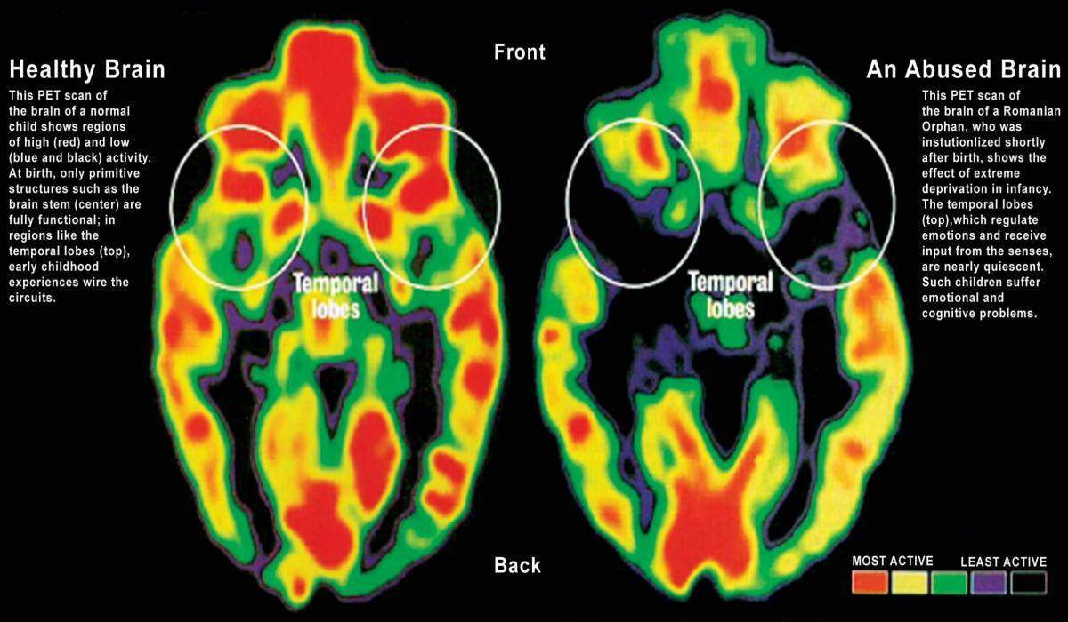
A Child’s Brain with Trauma
Notes:
This is a PET scan. It measure the amount of brain activity in various regions of the brain. For example: If I flex my left biceps . . .
The scan on the left shows normal function
The scan on the right is from a Romanian orphan who suffered extreme neglect. The circled areas show the poor brain function in that area.
From this technology we learned how trauma damages the brain, but we also learned that there are therapeutic modalities we can do to overcome that trauma!
We learned of the remarkable plasticity of the brain to generate new cells and create new pathways.
The term plasticity means that the brain is moldable, adaptable and can change over time, even after trauma.
These brain changes and others like them happen with all kinds of trauma: physical, emotional, abuse or neglect.
The good news is that we now know that we can change it back again!

Slide 25
Paradigm Shift: Positive-Focus
Instead of asking: “What’s wrong with this person?”
We ask: “What are the strengths of this person
and how can I help them?
Notes:
At about the same time as the ACEs study, there was a paradigm shift in psychology care from a PROBLEM-FOCUSED approach that concentrated on treating dysfunction and disease,
to a more POSITIVITY-FOCUSED approach . . . which is strength based . . . Enhancing the positives . . . instead of treating pathology.
Instead of asking “What’s wrong with this person?”
they began asking “What are the strengths of this person and how can I help?”

Slide 26
Studies of Resilience Emerge
Longitudinal studies
  Features of resilience
Resilience-Building in Schools
  Penn Resiliency Program
  Lincoln Alternative High School
Notes:
A direct result of the paradigm shift to positive psychology was the new emphasis on studying resilience in many research centers in the 90’s.
Many retrospective studies were done looking at the features of resilient people, and striking similarities were found across all of these studies.
Others prospective studies were done to look at how to build resilience in the school setting.
Let’s briefly look at the resilience literature.

Slide 27
Longitudinal Studies:
Features of Resilience*
Optimism
Flexibility
Love of learning
Self-motivation
Relationships
Service
Humor
Spirituality
Perseverance
Creativity
Perceptiveness
Independence in thinking
Competence
Self worth
* From Resiliency in Action, Nan Henderson MSW
Notes:
These are the features of resilient people as uncovered by multiple studies!
READ THEM QUICKLY
These features become our targets – what we aim for in building resilience.
I will talk more about these later.

Slide 28
Resilience-Building in Schools
Penn Resiliency Program*
Pennsylvania schools
Building resilience through teacher training
Showed lower depression and anxiety among students
US Army implementing a version of this programs to troops in basic training
* www.positivepsychology.org
Notes:
The first major prospective resilience study was conducted by Martin Seligman Ph.D. who led the Penn Resilience Program in Pennsylvania public schools.
They trained teachers to build resilience in the classrooms
Results over years showed significantly lower depression and Less anxiety among students.
The US army was so impressed with these results, they asked Dr. Seligman to create a version of this program to teach resilience to their troops.
All troops in basic training are going through Resilience-Building with hopes of preventing PTSD.
I actually confirmed this from one on my former patients who is currently attending West Point Academy.

Slide 29

Resilience-Building in Schools
Lincoln Alternative High School *
Study done in Lincoln H.S., an alternative school in Walla Walla, 2009-2013
  Students with disproportionately high ACEs score
  Introduction of trauma-informed, resilience-building practices to the teaching faculty
  Collaboration with medical and mental health services
A model for how a dedicated multidisciplinary team can build resilience in teenagers
* www.resiliencetrumpsaces.org
Notes:
Another prospective study was done in Lincoln H.S. in Walla Walla, 2009-2013
This was an alternative HS whose students have disproportionately high ACEs scores:
There was a high rate of abuse, family dysfunction, substance abuse, and school failure
This school introduced trauma-informed, resilience-building techniques to the teaching faculty
They utilized collaboration with medical and mental health services
This model demonstrated how a team of professionals can teach resilience to teens in the school system

Slide 30

Resilience-Building in Schools
Lincoln Alternative High School
Findings:
Resilience scores improved over the 4-year study in:
    Meaningful relationships
    Problem solving
    Optimism.
Academic Improvements were seen:
    In GPA
    test scores,
    truancy
Improvement was independent of ACE score!
Notes:
So what were the findings . . .
Resiliency can be taught:
Resilience scores improved over the 4-year study in:
Meaningful relationships
Problem solving
Optimism.
Improvement in GPA, test scores, truancy
Improvement was independent of ACE score!

Slide 31
What I Tell My Patients . . .
Benefits of Resilience:
  Academic improvement
  Optimism
  Problem solving
  Supportive relationships
  Prevent or improve anxiety and depression
  * Not a comprehensive list
Notes:
Literally I say this every day to my patients
Resilience has been shown to improve school performance, optimistic outlook, problem-solving, meaningful relationships and prevent or reduce anxiety and depression.
Parents love it and want to hear more.
I want to emphasize that resilience is not a treatment for trauma.
It is meant to be an adjunct to counseling from a specifically trained trauma therapist.
Trauma therapists now have some excellent evidence-based trauma therapies to use: EMDR, CBT, DBT and others
Traumatic Stress is a significant foe, and no one therapeutic modality can cure it’s toxic effects.

Slide 32

Brain Integration
Resilience-building in children
Notes:
Now I’d like to show you some science that helps us to understand how we can help.
This research helps us to understand how resilience-building through brain integration can help young children.
But this same science also applies to the Trauma-informed care of adults who suffer from traumatic stress.

Slide 33
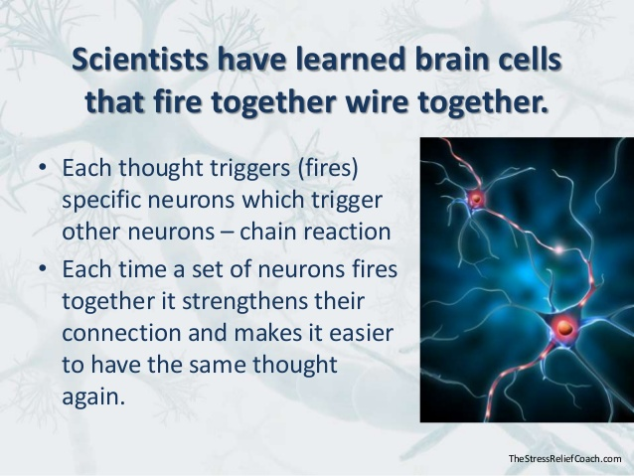
Brain Integration
Brain Plasticity
Notes:
Here is one scientific description of how brain plasticity works.
Neurons that fire together, wire together.
Every thought or behavior fires a group of nerve cells in our brain
THE MORE THIS ACTION IS REPEATED, THE MORE IT STRENGTHENS THE CONNECTIONS OF THE NERVE CELLS WORKING TOGETHER.
If you continue to repeat a thought or behavior, it will eventually become a habit.
This is the basis for Cognitive Behavioral Therapy, but we have the ability to coach some of this even though we are not therapists.

Slide 34
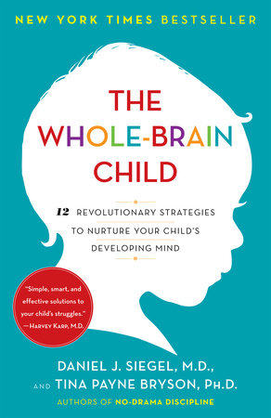
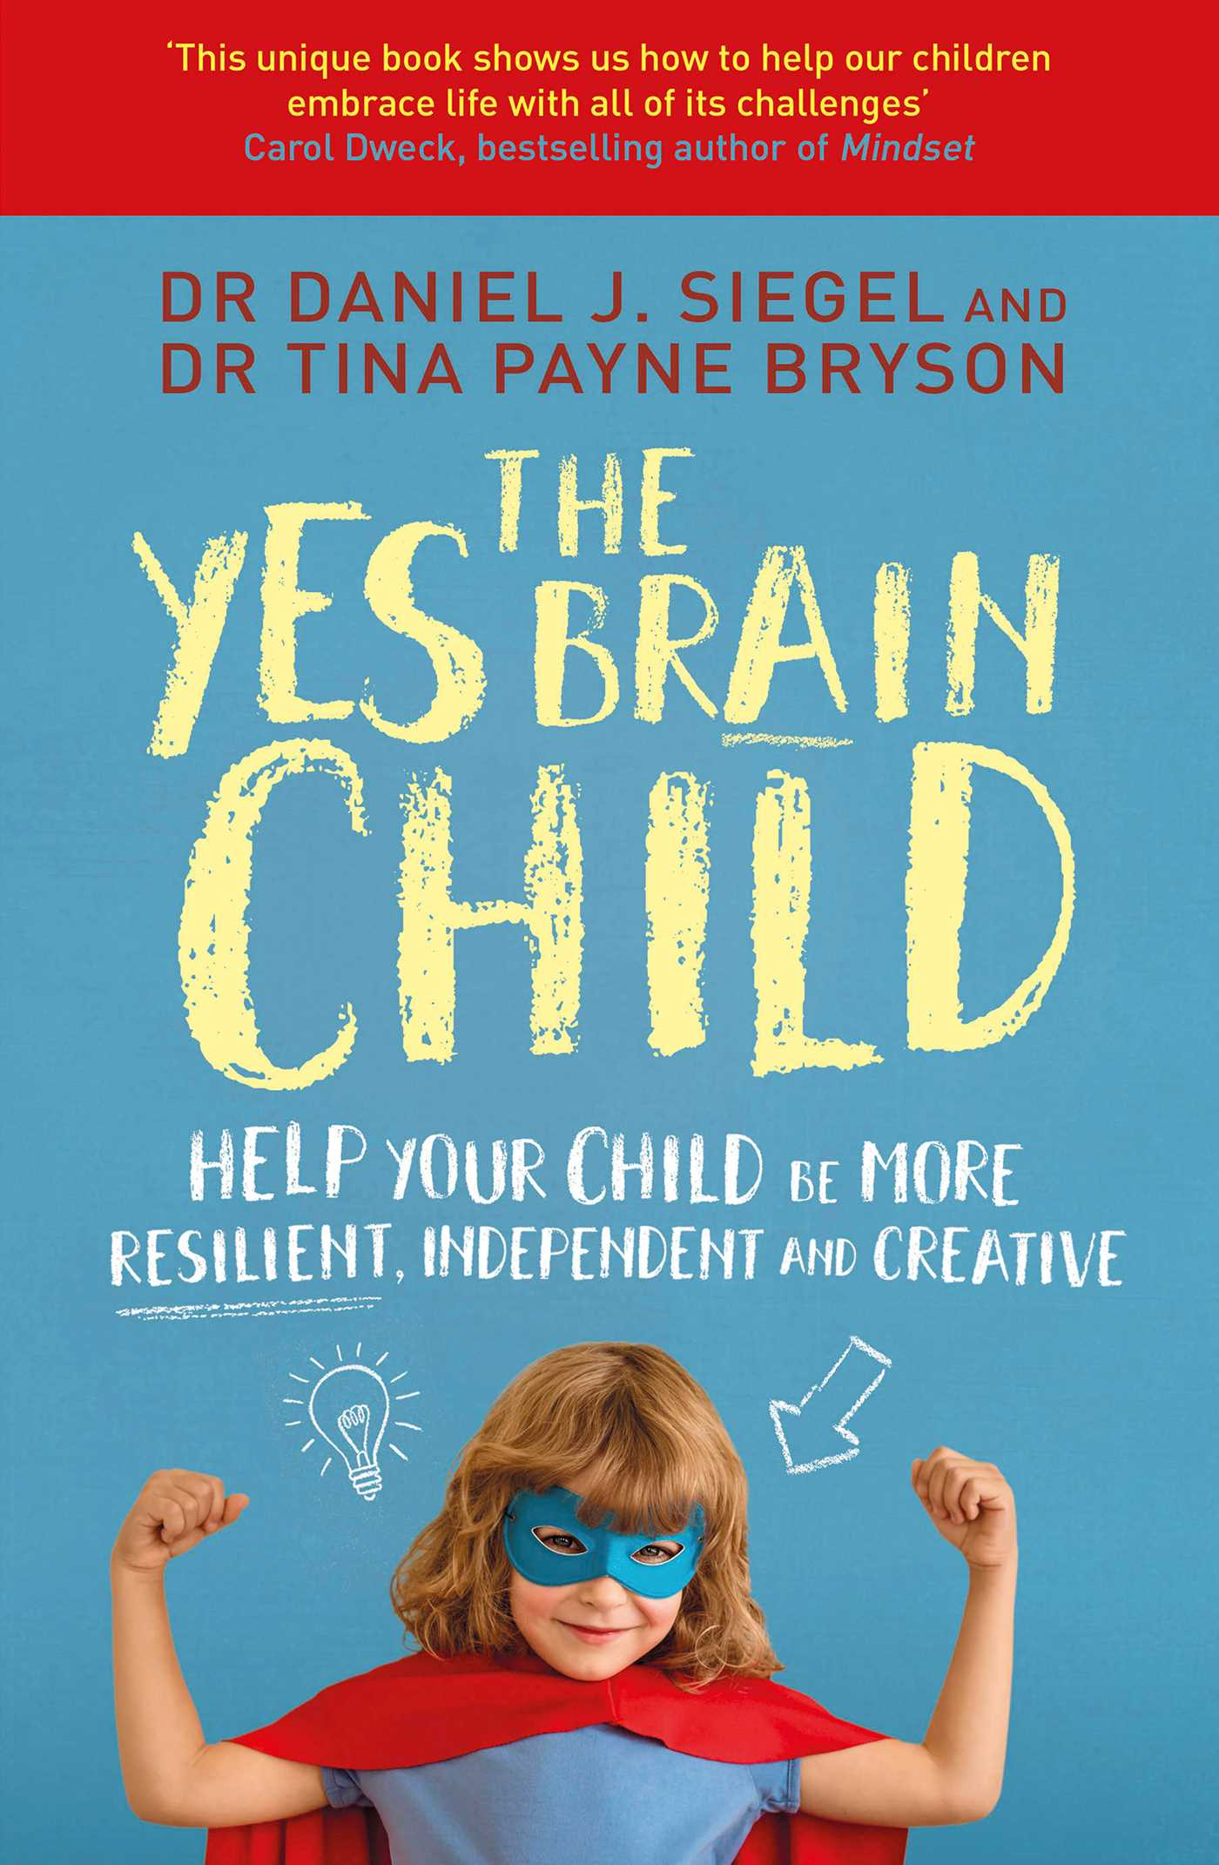
Daniel Siegel MD:
Brain Integration
Upper Brain:
Logic, planning, learning
Lower Brain:
Emotions, instincts and stress
Left brain:
logical, verbal, organization
Right brain:
non-verbal experience, emotions
The most highly functioning brains are those in which all areas of the brain communicate well with other parts of the brain.
Notes:
Dan Siegel, was one of the early researchers who utilized PET scans and functional MRI’s to correlate anatomical understanding of behavior.
This work was game changing in allowing us to understand trauma.
These are 2 of his books which I highly recommend.
Through this research we have learned specific roles that certain areas of the brain have
The Upper brain is responsible for logic, planning ahead, and most learning.
The Lower brain controls our instincts, our emotions and our stress reactions.
Our left brain usually is more verbal, and organized and logical,
Whereas our right brain is more experiential, emotional and non-verbal.
The most highly functioning brains are those in which all areas of the brain communicate well with other parts of the brain.
THIS IS WHAT WE CALL BRAIN INTEGRATION.

Slide 35


A Metaphor for Brain Integration
A tangled mess
Organized and orderly
Notes:
If will indulge me a little, this is how I describe the process of brain integration, and how it reinforces the need for us to be repetitive in what we do, and in what we ask our parents to do.
Picture me, brushing my daughter's hair on a weekend when mom is away. She awoke with “bed-head” and it is a tangled mess with each strand of hair going its own way.
The early brushing was difficult and sometimes downright painful.
But gradually by gently brushing hair, over and over, it became organized.
Eventually the brushing was easy, and the hair was all going in the same direction.

Slide 36



Brain Integration: Children
→
Notes:
When children are young, their brain cells are a tangled mess, not well organized or integrated.
Different parts of the brain work well independently, but they don’t work well together.
When brain cells work together, they start to associate with each other, and they work together in a coordinated fashion.
We call this integration.
Left Brain integrates with the Right Brain. Upper Brain integrates with the Lower Brain
For instance, the emotions part of the brain starts to listen to the logical side of the brain, allowing it to be less reactive.
Or . . . The verbal part of the brain can start to connect with the emotional part of the brain and explain things better
Gradually, with repetition and practice, these neurons start to become organized, with many groups of cells working together. “Neurons that fire together, wire together!”
Just as the gentle persistent brushing of the hair brings orderliness,
REPETITION OF BRAIN INTEGRATION ACTIVITIES bring orderliness and maturity of behavior.

Slide 37
Brain Integration: Children
→
Tangled hair: Immature thoughts and behavior
Hairbrush: Parents actions which help child to “integrate” and organize their thoughts
Brushing: Learning from life’s experiences with the thoughtful guidance of a parent.
Integration: Gradual, repetitive grooming of behaviors, enhancing the neuron connections
Notes:
So, to review:
Tangled hair represents Immature thoughts and behavior, with poor coordination of brain centers
Hairbrush:
Parents actions which help their child to “integrate” and organize their thoughts, language, emotions and behavior.
Verbalizing and role modeling.
Brushing of the hair:
Learning from life’s experiences with the thoughtful guidance of a parent, caretaker or professional
Integration:
Gradual, repetitive grooming of behaviors, enhancing the neuron connections.
This only happens with gentle persistence and repetition.
And that’s where we come in . . .

Slide 38
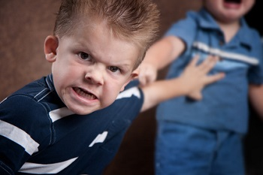
Brain Integration For Resilience-Building
Managing Emotions
Developmental Process:
2 yr old:
  Acts out their feelings
3 yr old:
  Learning how to label their feelings
4 yr old:
  The goal is to coach them to use their words and logic to avoid the need to display their feelings
6-8 yr old:
  Able to calmly resolve differences with words and forethought
Notes:
OK, lets take that science and get practical.
Think of normal behavior of a child starting with the toddler age.
There is a normal developmental process that happens over time.
Some of the kids you work with have challenges in their communication or other developmental delays, and this complicates the timeline some but the process will still be the same.
2 yr old: Displays their feelings
3 yr old: Learning how to label her feeling
4 yr old: The goal is to coach them to use their words and logic to avoid the need to display their feelings
6-8 yr old: Able to calmly resolve differences with words and forethought

Slide 39
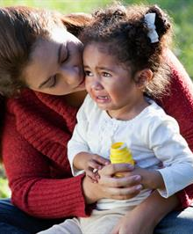
Brain Integration: Children
Teaching Tools
2-year-old:
  Role model calm, gentle words, labelling their emotion
3-year-old:
  Teach how to label her feelings
  “Debrief” and discus after episodes, when calm
4-year-old:
  The goal is to coach them to use their words and logic to avoid the need to display their feelings
6-8-year-old:
  Coach them to calmly resolve differences with words and forethought. Teach empathy.
Notes:
So how do we teach this brain-integration process in our work with parents.
We role model
Show parents how to do this and let them know why.
We are trying to connect the feelings center of the brain with the logical/verbal section of the brain so that there can be more integration.
For the 2 yr old:
Role model calm, gentle words, labelling their emotion
3 yr old:
Teach how to label her feelings, Discus after episodes occur (debrief after the flipped lid comes back down)
4 yr old:
The goal is to coach them to use their words and logic to avoid the need to display their feelings
6-8 yr old:
Coach them to calmly resolve differences with words and forethought

Slide 40

Brain Integration: Trauma
Notes:
Now, I would like to apply the same concept of brain integration to adult survivors of trauma and ACEs.
The prevalence statistics have shown us that we will be seeing families with significant trauma approximately 10-15% of our visits.
How can we help those families?

Slide 41
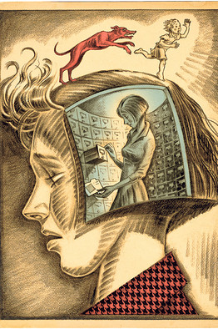
Neurophysiology of Traumatic Stress
A traumatized brain struggles with the “filing away” of trauma memories, so that old memories can be triggered by present circumstances
The connections between a traumatized “upper brain” and “lower brain” are disrupted, which limits the ability to verbalize and discuss the trauma
The lower brain becomes overactive, so that emotions are easily triggered.
Notes:
The study of PET scans and functional MRI’s in people with traumatic stress have showed us how TRAUMA CAN CAUSE SIGNIFICANT DYSFUNCTION in brain connections:
A traumatized brain struggles with the “filing away” of trauma memories, so that old memories can be triggered by present circumstances
The connections between a traumatized “upper brain” and “lower brain” are disrupted, which limits the ability to verbalize and discuss the trauma
The lower brain becomes overactive, so that emotions are easily triggered, and the symptoms of fight/flight/freeze show up even when there is no apparent danger.

Slide 42
Brain Integration: Trauma
Trauma-Informed Care
→
Notes:
Traumatic stress can lead to poor brain integration.
This process is different from the immature brain of a child, but the poorly integrated brain from traumatic stress can be addressed in a similar way.
We can help!!!
THAT ARROW ON THIS SLIDE IS US!
The same modeling and coaching that we do for children will help a trauma survivor to re-integrate their brain.
Think of the opportunities we have to be therapeutic to trauma survivors.
When you improve brain integration by building resilience in a parent, you are also treating their child – building resilience in 2 generations!
This is the exciting part of what we get to do to help these families.

Slide 43
Brain Integration for Trauma Survivors
Trauma-Informed Care
TRAUMA SURVIVOR:
Goals:
Strong supportive adult peer
Counseling
Ability to build upper brain functions even during stressful times
Knowledge of triggers and how to de-escalate
Notes:
So here are the goals that we can set for building resilience for an adult trauma survivor:
Help encourage them to have a strong supportive adult peer: studies show how important this is
Counseling is recommended and is evidence-based especially when performed by a specifically trained trauma counselor.
We can encourage them to build “upper brain” functions even during stressful times.
And it is very important for them to know what triggers their trauma and how they can de-escalate.

Slide 44
Brain Integration for Trauma Survivors
Trauma-Informed Care
TRAUMA SURVIVOR: Goals
HEALTH CARE WORKERS Tools
Strong supportive adult peer →
Counseling help if needed →
Ability to work through difficulties → using “upper brain” functions.
Knowledge of triggers and how to →
de-escalate
Encourage Connection: Review Circle of Support
Utilize local resources and notify PCP
Role model upper brain functions: demonstrating calm speech, logic, problem solving, persistence
Teach De-Escalation.
Encourage mindfulness, yoga, other grounding activities
Notes:
So here are some of the tools that we can use to help our parents that struggle with traumatic stress
Encourage connection with an adult peer: We will talk about the Circle of Support in a moment and this is a great tool for this
Help encourage counseling if they need it and let us PCP’s know
Role model integrated behavior and label what you are doing: connecting the parts of the brain. Encourage repetition.
Help them to understand their triggers and learn how to de-escalate through mindfulness, grounding. Again, we will discuss this later.

Slide 45
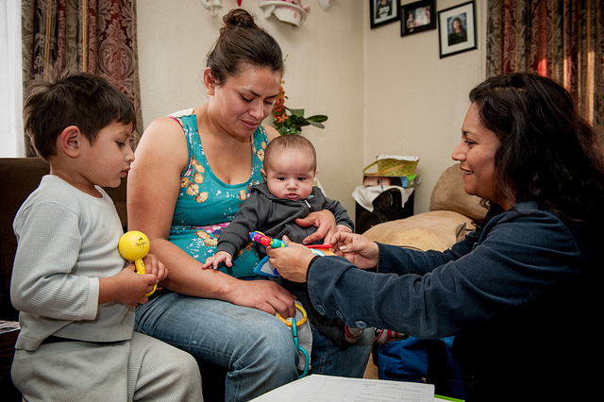
Brain Integration Example for an Adult Trauma Survivor
Trauma-Informed Care
Notes:
So . . . What might this look like?
Think about this:
You may be struggling with a family in meeting your OT, PT or speech goals because the family is not following through,
Think about how this might be a side effect of trauma.
Here is a potential scenario: mother doesn’t follow through with the prescribed work for her child because, in her mind, she is imposing limits and control over her child, which makes her child unhappy
In her childhood, when she was experiencing trauma, she was in a position of having no control.
When she pushes her son to do things he doesn’t want to do, this upsets him and triggers her trauma memories, causing her to freeze and not follow through.
You can help her to recognize this pattern and de-escalate when he gets upset,
You can help her work through these issues:
To learn that raising expectations for his behavior
and challenging him is actually showing love to her son, not control.
You may need to change your priority of treatment to include addressing the trauma effects on the family, so that you can adequately address your other goals
I WANT TO SAY THAT AGAIN WITH A LITTLE MORE EMPHASIS:
You may have specific PT, OT or speech goals for the child, but your biggest therapeutic success might be helping the parent learn brain integration and upper brain functionality. This is a huge accomplishment for a trauma survivor.

Slide 46

Questions?
Notes:
So far, I’ve just laid the foundation for resilience building:
explaining the basis for targeting ACEs
showing the evidence for why we are building resilience,
and some of the science of how it works both for children and for trauma survivors
So, let’s take some time to see if you have any questions.

Slide 47
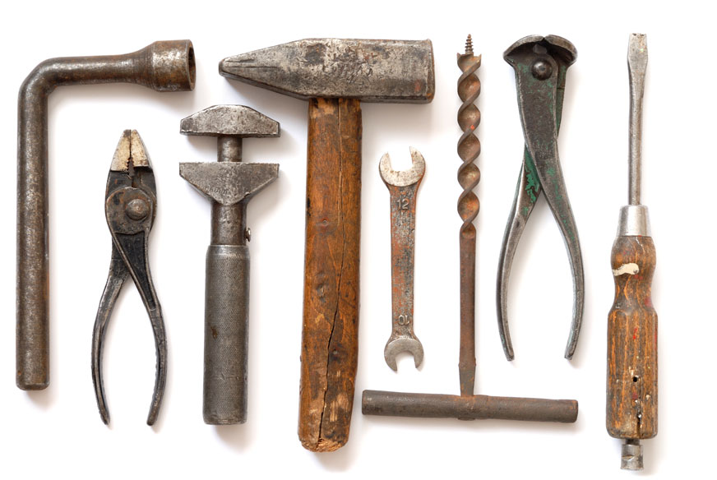
Resilience-Building Tools
Notes:
So . . . How do we build resilience.
These are a few of the tools that we taught to the pediatricians.
All the tools the we are demonstrating today are:
Evidence-based
Designed to be easily understandable
Designed to be brief: to be delivered within 2-3 minutes in our office settings
I am going to give you 8 examples of tools that I use in my office every day.
I don’t expect that you would use all of them, but start with one that resonates with you, and start talking about it with your families.
It will become easier to bring up the subject of resilience over time, and then you will find specific circumstance in which you will bring the subject up.

Slide 48
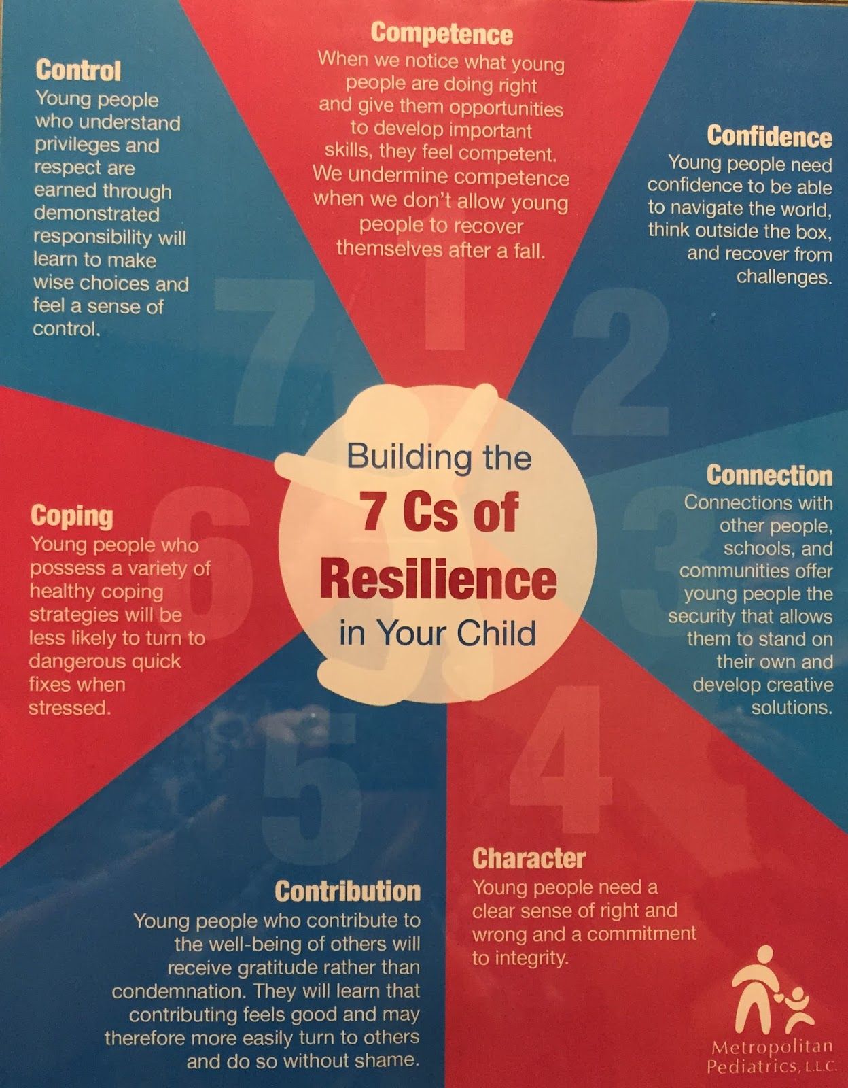
In-Office Tools
The 7 C’s of Resilience*
Competence
Confidence
Connection
Character
Contribution
Coping
Control
* www.fosteringresilience.com, Kenneth Ginsburg, MD
Notes:
Ken Ginsburg, a pediatrician and adolescent specialist, who has researched and written extensively on resilience.
The 7 C’s is a clever way for us to teach our families what the components of resilience are.
Children’s Health Alliance adopted the 7 C’s as a tool to explain the goals of building resilience.
When I talk with families, it is easier to talk about the 7 C’s, than to list the 14 features of resilience listed on the previous slide.
Nobody has all of these features, be we can all set these as realistic goals as we build our own resilience.
Competence: what you do well: academics, art, athletics, being a good friend, listening . . .
Confidence: often comes from our competence, having the strength to try new things
Connection: relationships are important, and provide support and strength for the individual
Character: having a sense of right and wrong, knowing who you are: family, culture, values, faith
Contribution: the ability to help others, make your world a better place
Coping: having healthy ways to get through a crisis or challenge
Control: knowing how to maintain your self control, but also having the skills to be able to advocate for yourself or others in controlling your environment

Slide 49
Tool #1
Do You Know What Resilience Is?
Define it:
      The ability to face a challenge,
      Meet that challenge, and
      Become stronger in the process
Explain how it helps:
      Resilience builds optimism
      Improves meaningful relationships
      Reduces anxiety and depression
      If you build it in your child, it will improve their performance in school
Use a metaphor:
Basketball
Butterfly in a coccoon
Notes:
Our first tool is to simply introduce the topic of resilience: Have you heard of resilience?
Define it:
The ability to face a challenge,
Meet that challenge, and
Become stronger in the process
Explain how it helps:
Resilience builds optimism
Improves meaningful relationships
Reduces anxiety and depression
If you build it in your child, it will improve their performance in school
Use a metaphor:
Basketball
Butterfly in a cocoon
Girl riding a bike

Slide 50
Tool #2
“What Are Your Strengths?”
  “One of the ways to become more resilient is to learn what our strengths are.”
  Help parents to see their child’s strengths
  Help parents to identify their own strengths
Notes:
The second introductory question is “What are your strengths?”
Now in my office, there are 2 scenarios where this may happen:
1. When I have a parent of a younger child, my goal is to help the parents find their strengths, and also to coach them to find the strengths of their child – whatever the age
Remember you will see things in them that they don’t see or believe in themselves.
Keep telling them their strengths so that they can own it.
2. When the child is old enough (grade school or older) I will ask the child what their strengths are. Then their parent.
The child will be concrete, the adult more abstract, but both are important.
Then I tell every parent, it is important that your children know their strengths. When they hear it from us, they claim it, they own and then build it some more.

Slide 51

Personal Strengths:
How Do We Help People Find Their Strengths?
Ask them. What do they think they are good at?
Observe them. Name their strengths and reinforce them with positive words
Grow them. Give them opportunities to expand their strengths and build new ones.
Notes:
So how do we help parents to find their strengths . . . And to find strengths in their children.
Ask them. What do they think they are good at?
Observe them. Name their strengths and reinforce them with positive words
Grow them. Give them opportunities to expand their strengths and build new ones.
I recommend writing the strengths of your parents down and bringing them up at a later time.
It is incredibly powerful when someone tells you you’re good at something, and then repeats it again in another setting or time.

Slide 52

Environmental Strengths:
Building Resilience In a Child’s Environment
Evidence-based Environmental Factors Than Build Resilience:
Strong parental figure or a supportive adult: family member, teacher, community worker
A reliable group of friends: knowing that “someone is on my team”
Connection: with peers, in school, in community
Strong cultural identity and ethnic pride
Notes:
So, while it is important for all of us to know our own personal strengths and grow them . . . It is also crucial for all of us to have a safety net that surrounds us and gives us additional strength when we don’t feel that we can do it alone.
Resilience Studies have shown:
1. We all need a STRONG SUPPORTIVE OTHER IN OUR LIFE. Usually, it is a strong parental figure, but it could be another supportive adult: family member, teacher, community worker
2. Having a reliable group of friends is important. A well-known trauma psychiatrist Bessel Van Der Kolk states it “EVERYONE NEEDS A POSSE”.
3. Connection with others is important: with peers, in school, in community
4. Studies have also shown that another environmental strength comes from a Strong cultural identity and ethnic pride
Sometimes, the families we take care of don’t have any of these environmental strengths.
That will be our goal to help them find them: parent groups, churches, community centers to allow them to find ways to build this.

Slide 53
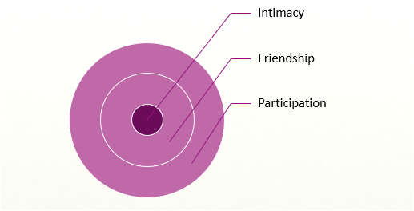
Tool #3
Building Connection
Circle of Support
adapted with permission from Kim Davis IIDC
Notes:
The Circle of Support tool to build connection and environmental support.
I use this in 2 specific circumstances: new parents, and teenagers.

Slide 54

Tool #4
Building Competence and Confidence
The Believing Mirror
Encourage: “Give Courage To”
Be the believing mirror
    “You have what it takes!”
    “You are strong!”
    “You can do this!”
Notes:
ONE OF THE BEST WAYS TO BUILD CONFIDENCE IS TO LEARN HOW TO ENCOURAGE.
THE WORD ENCOURAGE LITERALLY MEANS TO GIVE COURAGE TO.
Remember parents don’t often receive positive comments about their parenting.
We can be a believing mirror: we reflect back a strength that they don’t even realize in themselves!
Praise is important. Let them know when they have done well.
But don’t dwell on the results, which are sometimes hard to come by.
Focus on the process and effort which is needed for the future
Resilience is a mind set: a decision to focus on strength, to be optimistic, and persistent.

Slide 55
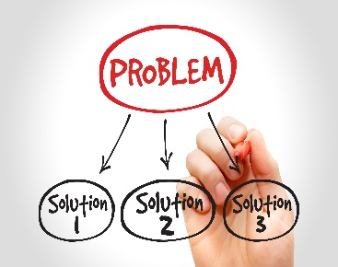
Tool #5
Building Competence: Problem Solving
Notes:
If you recall from the resilience literature, the ability to solve problems is a strength that resilient people have.
When you encounter a challenge or a problem, you set about trying to solve it.
Solution #1 is tried and fails. Don’t give up, keep working and try solution #2 or #3.
Think of the features of resilience when you coach this:
persistence,
flexibility,
Creativity
And you can provide the optimism and encouragement
Allowing a child to experience this process early in life with minor challenges can build resilience for future serious life challenges.

Slide 56
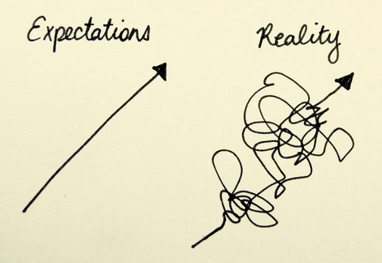
Tool #6
Building Confidence: “Failure”
What is failure?
When we don’t meet our expectations
  Difficulty in school
  Difficulty in relationships
  Losing in a game
  Criticism from others
  Not reaching our goals
Everyone fails at one time or another.
Encourage the use of the word “Yet”
The only true failure is if we give up!
Notes:
One of the 7 C’s of Resilience is that of confidence, and we can build confidence in both our parents and in their kids.
A great way to build strength and resilience is through allowing them to experience failure and learn from it.
What is failure?
When we don’t meet our expectations:
WHAT OPPORTUNITIES DO WE HAVE TO BUILD THROUGH FAILURE?
Difficulty in school: Homework example with my kids
OTHER OPPORTUNITIES:
Acquiring a new developmental or academic skill
Playing board games: 5-year-olds
Criticism from others: Coach them to recognize their strengths. “Can anyone take those away from you?”
We all fail at one time or another.
Encourage the use of the word “Yet”.
The only true failure is when we give up.

Slide 57
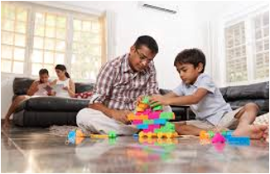

Tool #7
Building Connection: Special Time
10 minutes, 1 on 1,
Parent and child, no interruptions
Just listen
The child is in charge of the activity or subject matter
Notes:
Special Time is an excellent tool for building connection in a parent and child.
10 minutes, 1 on 1,
Parent and child, no interruptions
Just listen
The child is in charge of the activity or subject matter
In toddlers and preschoolers, this has tremendous behavioral rewards: they love bossing us around, and when we give them that control, they often won’t demand it later
In school age and teens, it’s a great chance to catch up. Just listen. You have no parenting agenda at this time
Try for 10 minutes per day 1-3 times a week
Try to keep from distractions.
Call it by their name: “Annie’s Time”.
If you see their behavior starting to escalate, you can call out: Hey Annie, I’m thinking that we can have some Annie’s time when I am done doing the dishes. You may want to think about what you want to play or do.
Be intentional in scheduling it. Putting value on this time allows the child to recognize how much you value them.

Slide 58
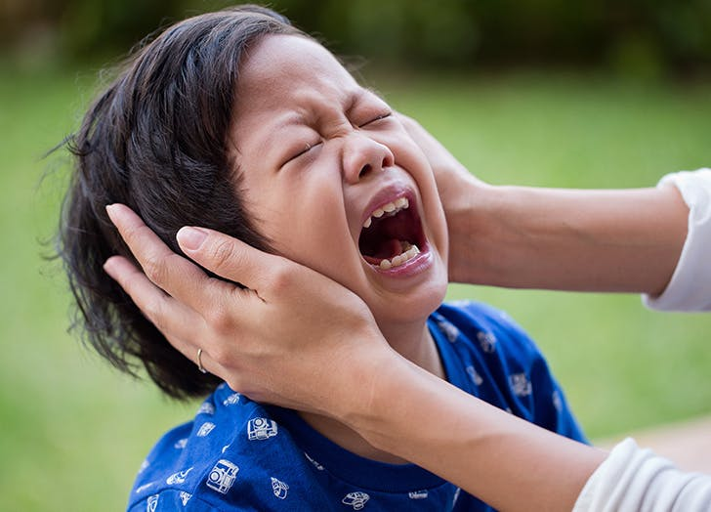
Tool #8
Building Coping and Control
Managing Emotions: The “Flipped Lid”
Daniel Siegel MD
Notes:
One of the hall marks of resilient people is knowing how to control one’s emotions during challenges and find ways to cope when difficult circumstances arise.
Daniel Siegel MD, came up with a brilliant way to talk with parents and patients about the brain and behavior.
He calls describes it as a Flipped Lid

Slide 59
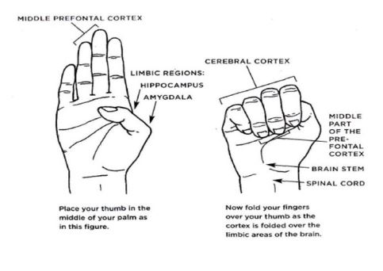
Hand model of the brain⁶
Daniel Siegel, MD
Notes:
Let’s talk first about brain anatomy and physiology.
Show open hand: spinal cord, brainstem, limbic system, amygdala, hippocampus, cerebral cortex, prefrontal cortex.
But we can simplify it even more to help explain behavior, I am going to talk about the function of the lower brain, and the upper brain.

Slide 60
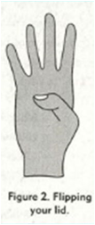
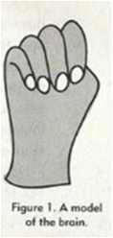
Functions of the Brain
Lower Brain:
Brainstem
Limbic system: amygdala, hippocampus
Breathing and heart rate
Protective instincts and reflexes
Emotions: fear, anger, anxiety
Upper Brain:
Cerebral Cortex, Prefrontal Cortex
Organized thoughts
Learning
Planning
Concentration
Notes:
Demonstrate the hand:
The LOWER BRAIN is primitive and concerns itself with 3 main functions:
Control our basic physiology functions such at HR, BP and breathing
It is also the center which controls our protective instincts and reflexes
Thirdly it is the center for our emotions and feelings.
The UPPER BRAIN is more sophisticated. It allows us think carefully, be logical, to learn and to plan ahead. It’s what allows us to make wise, smart decisions!
In most circumstances the upper brain forms a protective covering over the lower brain allowing us to be clear minded and rational.
When the lower brain is in control, Dr. Siegel calls this a “flipped lid”.
This happens frequently in children but can happen in all of us.
It’s a good thing to know about when you are a parent: because the upper brain isn’t helpful during these times!
Once the lid is flipped no amount of parenting or teaching will be successful.

Slide 61
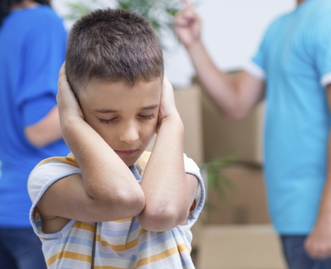
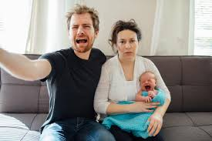
What Does a Flipped Lid Look Like?
Lower brain becomes overactive
  Fight: anger, temper
  Flight: distracted, hyperactive, worried
  Freeze: withdrawn, overly compliant
In a child:
In a Trauma Survivor:
Notes:
A flipped lid is when our lower brain takes over: the emotions, the stress reactions, and the physical changes in our bodies.
The survival instincts of Fight, Flight, Freeze can be set off even when there is no immediate danger.
THE FIGHT REACTION is manifested as anger, temper, violence
FLIGHT REACTION is characterized as looking distracted, hyperactive, impulsive, always worried
EVEN THE FREEZE REACTION can be seen as a person who is withdrawn, overly compliant, or “shut down”.
It’s important to know that kids are not the only ones who flip their lid.
We all have times when our emotional brain overtakes our cognitive and logical brain.
I would be remiss if I didn’t remind you of your Trauma-informed training and talk about how trauma survivors look when their lids are flipped.
Notice the reactions of this young family
The baby is crying loudly
Father is angry: this may be his fight reaction
And the mother is withdrawn and shut down: this may be her freeze reaction
Our job is to recognize these situations and provide therapeutic benefit.

Slide 62


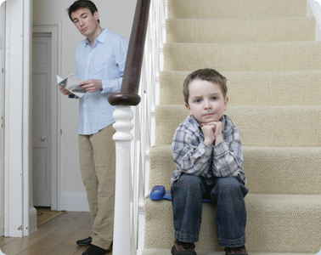
Coping
De-Escalation: Todders
Attunement
Distraction
“Cool Down” Location
“I understand"
  Bubbles
Notes:
So can we help?
Our goal, as parents and caretakers is to recognize when someone’s lid is flipped and help them to restore control.
De-Escalation restores calm to them, but also allows them to regain their upper brain functionality.
We all need some strategies for de-escalation,
In babies and toddlers, a flipped lid could be from pain, from fear, or from anger. (don’t forget tired, hungry!)
De-escalation is sometimes just attunement: just being present and seeing what they need.
Distraction is actually an excellent technique for de-escalation. We use bubbles in our office
If the tantrum is more volitional and planned, selective ignoring the behavior is entirely appropriate: giving them a place to “cool down”
“Time Out” shouldn’t necessarily be a consequence, but rather, think of it as a “cool down” period.

Slide 63
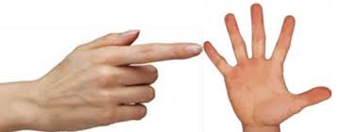

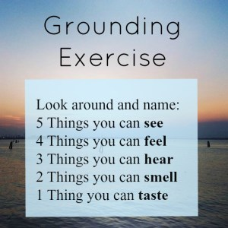
Coping
De-Escalation: Adults and Older Children
Breathing Exercises
Grounding Exercises
Notes:
2. In an older child or adult: breathing techniques or grounding exercises can be used.
Breathing exercises are an excellent coping technique:
remember that one of the strengths of the lower brain is the control of breathing:
breathe by tracing your hand
Breathe2Relax is a free App that teaches de-escalation and mindfulness: teaches controlled belly breathing
Grounding exercises:
Grounding exercises are things you can do to bring yourself into contact with the present moment – the here and now.
They are helpful when emotions are out of control: during a trauma flashback, an anger outburst, or a panic attack
There are many out there, but this is one that is easy. It allows the escalated person to re-gain their senses by becoming more aware of their body and their environment.
List 5 things you can see, 4 things you can feel . . .hear. . . Smell. . . taste . . . Etc.

Slide 64

One More Target?
Evidence-basis for Preventing Burnout in Health Care Workers:
Recall the transitive property from math class:
  If A > B, and B > C, then A > C
Studies have shown:
Teaching Resilience → Builds Resilience
Building Resilience → Prevents Burnout
Therefore: Teaching Resilience → Prevents Burnout
Notes:
As I wind down in this talk, I need to talk about a subject that is on everyone’s mind during the Covid pandemic.
Burnout is becoming more of a concern in health care workers.
Resilience can help.
We now have some evidence-based data to help combat burnout in health care workers.
Recall the Transitive Property from math class
If A > B, and B > C, then A > C
So how does this apply to resilience and burnout. Stick with me for a second.
1. It has been shown that the act of teaching resilience builds resilience in the teacher
2. There is growing evidence that building resilience in health care workers can prevent burnout and enhance satisfaction
Therefore, when we teach resilience-building, we are immunizing ourselves against burnout!

Slide 65
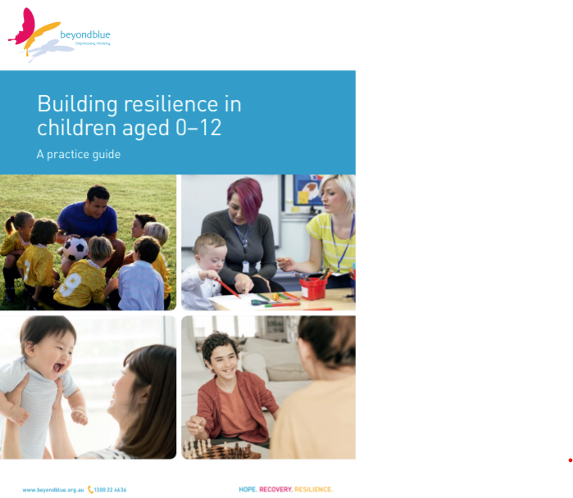
Opportunities for More Learning About Resilience-Building
For Educators and Community Workers:
Beyond Blue
https://resources.beyondblue.org.au/prism/file?token=BL/1810_A
Notes:
I could easily talk for another hour about the new and exciting literature that is emerging about resilience-building. Here are a couple of resources.
Beyond Blue is an organization based in Australia dedicated to prevention and treatment of anxiety and depression in youth. They developed this guide as a part of the Children’s Resilience Research Project.
Beyond blue believes that to promote children’s resilience, it’s necessary to develop a common language, so they developed this 66-page guide. As someone who has read much of the scientific literature on resilience, this guide is concise, thorough and practical all at the same time.
The information within the guide was based on:
Review of the resilience literature
A taskforce of 10 child resilience experts across Australia
An expert panel of 25 academic researchers, leaders of services for children and families as well as community leaders
They solicited feedback from School aged children, age 6-12, and their parents
They also included Practitioners in health, education and community services sectors

Slide 66
Opportunities for More Learning About Resilience-Building
  Resilience in Children:
  Developmental Perspectives.
  Masten and Barnes.
  July 2018
  Modifiable Resilience Factors to Childhood Adversity for Clinical Pediatric Practice.
  Traub and Boynton-Jarrett.
  November 2016.
Resilience Review Articles
Notes:
In addition to the Beyond Blue document, I want to include what I think are the best recent review articles about resilience.
1. The first article by Anne Masten is the most comprehensive review of the Resilience Literature.
It is equally evidence-based and practical for all of us as well.
2. The second article by Traub looks at the Factors that build resilience and how we as practitioners can modify them.
This article was chosen by the American Academy of Pediatrics editorial board as one of the most influential articles for pediatricians in 2019.

Slide 67
Opportunities for More Learning About Resilience-Building
  Positive Childhood Experiences and Adult Mental and Relational Health​
  Bethell, et al: JAMA Pediatrics. September 9,2019
  Benevolent Childhood Experiences (BCEs) in Homeless Parents​
  Merrick, Narayan, Masten, J Fam Psychol. June, 2019​
  ACEs and Counter-ACEs: How Positive and Negative Childhood Experiences Influence Adult Health.​
  Crandall PhD, AliceAnn, et al, Child Abuse and Neglect,
  July 27, 2019​
Protective Factors:
Positive Childhood
Experiences
Notes:
The last group of articles, in my opinion are game changing.
They describe Positive Childhood Experiences which are perhaps more important than Adverse Childhood Experience.
These articles are only a few years old but are extremely influential in showing protective factors that build resilience.
We are happy to see that these articles confirm the work that CHA started 4 years ago.
We believed, somewhat on faith, that building resilience would be a way to proactively address ACEs.
This recent work gives us more incentive to keep doing the work that we started.

Slide 68
Targeting ACEs
Understand ACEs, Trauma and Resiliency
Trauma-informed Care
Building Resilience
Building Resilience
3 Targets: Children, Parents, Ourselves
Notes:
So we began today talking about ACEs and trauma which can have some devastating consequences
But we have also showed you evidence based interventions that can overcome the consequences of trauma.
Resilience-building interventions have 3 specific targets:
Children: preparing them for future challenges
Parents: building resilience in them, whether we know of their trauma or not
Ourselves: Building our own resilience by teaching it to others

Slide 69
Building Resilience in Children and Families
Dean Moshofsky, MD
dmoshofsky@metropediatrics.com
Notes:
Thank you again for the opportunity to be here today.
I have left my email here if any of you would like to contact me.
Do you have any questions?

Slide 70

Questions?

Slide 72
Beyond Blue
https://resources.beyondblue.org.au/prism/file?token=BL/1810_A
Notes:
Beyond Blue is an organization based in Australia dedicated to prevention and treatment of anxiety and depression in youth. They developed this guide as a part of the Children’s Resilience Research Project.
Beyond blue believes that to promote children’s resilience, it’s necessary to develop a common language, so they developed this 66 page guide. As someone who has read much of the scientific literature on resilience, this guide is concise, thorough and practical all at the same time.
The information within the guide was based on:
Review of the resilience literature
A taskforce of 10 child resilience experts across Australia
An expert panel of 25 academic researchers, leaders of services for children and families as well as community leaders
School aged children, age 6-12, and their parents
Practitioners in health, education and community services sectors

Slide 73
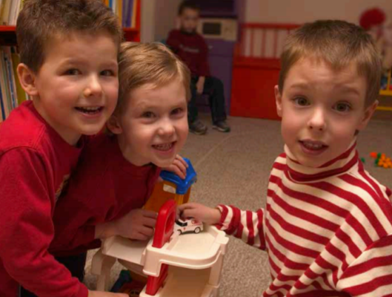
Beyond Blue:
Should We Build Resilience or Prevent Adversity?
In theory preventing adversity is preferable, it is not always possible in practice
It is easier to build resilience than to prevent adversity
Notes:
This is a very complex slide from the beyondblue text, which looks at the Factors that influence a child’s reaction to adversity.
The experts from beyond blue agreed with 100% consensus that resilience interventions should focus on both the child and their environment.
I can now honestly say, that pediatricians in the Portland/Vancouver/Salem area are earnestly working on resilience building in the inner two circles of this diagram: the children themselves and their families.
What I am going to ask you all to do is to carry out this work to the next layer: that of the schools and the community. The blueprint has now been written by our colleagues in Australia. We need people here to carry out this blueprint.

Slide 74

Beyond Blue:
Should We Focus on The Child or on Their Environment?
Interventions for the child:
  Skills building, managing emotions, handling failure
Family interventions:
  Parenting skills, connectedness, family relationships
Community:
  Peers, schools, community groups
The experts from Beyond Blue agreed with 100% consensus that resilience interventions should focus on BOTH the child and their environment.

Slide 75
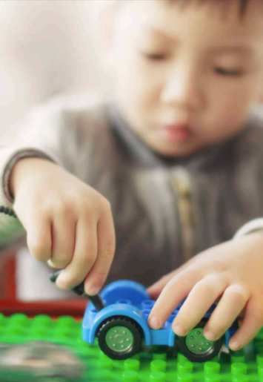
Beyond Blue:
What Kind of Interventions Should We Look At?
Terminology:
Universal Interventions:
  Build resilience across all levels of risk
  Builds “Promotive Factors” for resilience building.
Targeted interventions
  Special role in the context of high adversity or risk
  Builds “Protective Factors” for resilience.

Slide 76
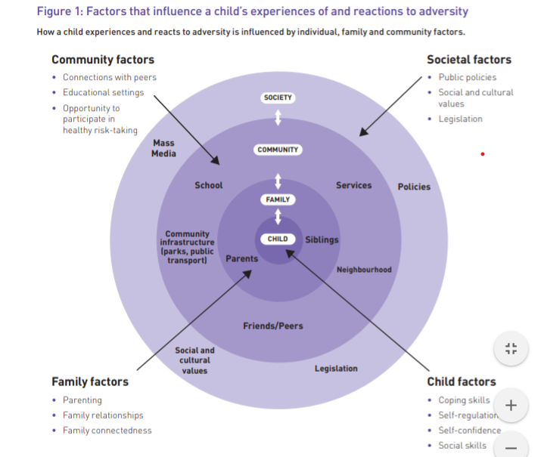
An Opportunity and a Challenge
Notes:
This is a very complex slide from the beyondblue text, which looks at the Factors that influence a child’s reaction to adversity.
The experts from beyond blue agreed with 100% consensus that resilience interventions should focus on both the child and their environment.
I can now honestly say, that pediatricians in the Portland/Vancouver/Salem area are earnestly working on resilience building in the inner two circles of this diagram: the children themselves and their families.
What I am going to ask you all to do is to carry out this work to the next layer: that of the schools and the community. The blueprint has now been written by our colleagues in Australia. We need people here to carry out this blueprint.

Slide 77
An Opportunity and a Challenge
Recommendations from Beyond Blue:
Intervening during the early years is especially important for improving outcomes for vulnerable and at-risk children.
Although some young children will be exposed to resilience interventions (for example, in ECEC settings), there will always be some children who ‘fall through the cracks’ because they are not attending services.
Deliver targeted resilience interventions in universal settings for children who are vulnerable and at-risk and have minimal contact with ECEC settings.

Slide 78
An Opportunity and a Challenge
Recommendations:
Tailor targeted resilience interventions to the unique circumstances of children to ensure they are appropriate to the type of adversity the child is experiencing and the intensity of support they need.
Ensure you have options available for children and families who need or request additional specialist support to deal with adversity or trauma (e.g. a list of available specialist services and referral options.

Slide 79
Building Resilience in Children and Families
Dean Moshofsky, MD
dmoshofsky@metropediatrics.com
Notes:
Thank you again for the opportunity to be here today.
I have left my email here if any of you would like to contact me.
Do you have any questions?

